Slide 1




Herbivory and sea urchin predation
for ecosystem resilience
By Charlotte Johansson, David Bellwood and Martial Depczynski

Slide 2
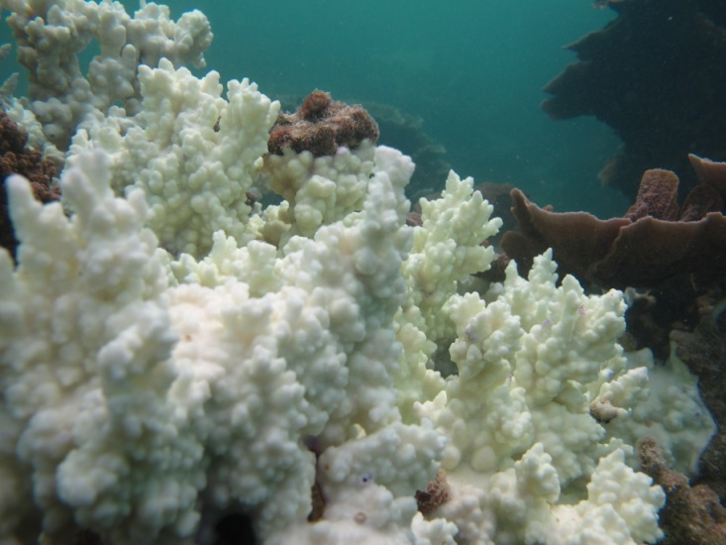
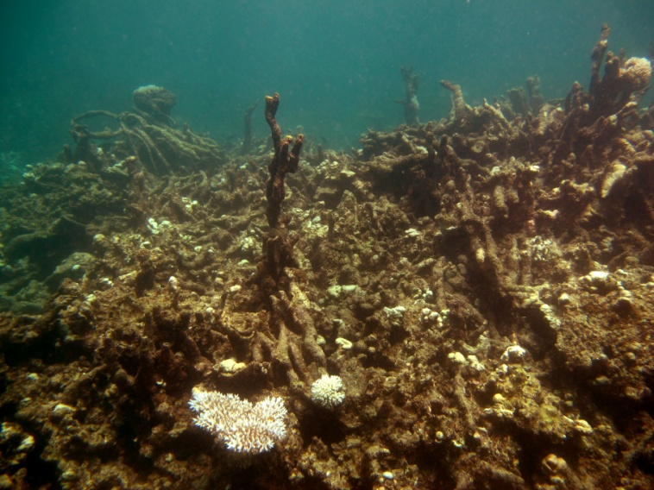
Introduction
Coral reefs under pressure
Human impacts
Increasing disturbance to reefs
Loss of vital functions (ecological roles)
Gradual erosion of resilience
Notes:
As we are most aware of, coral reefs are under immense pressure today
and this is mainly due to human activities
This leads to incr number of disturbances on reefs
and a loss of vital ecological functions and ecological roles
But also gradually erodes the reef resilience
Thank you David
Hi and welcome to my talk titled…
This is a collaboration with Prof D Bellwood at James Cook University and Dr M Dep at the Australian Institute of Marine Science

Slide 3
Introduction
Resilience
“the capacity of a system to absorb disturbance and reorganize while undergoing change so as to still retain essentially the same function, structure, identity and feedbacks”
(Walker et al 2004)
To understand how ecosystem processes will be affected by disturbances we need to look at the species that contribute to them and what the strength of their combined functional role is
Notes:
There are many def of resilience, this is the one I use
Read slide
To understand how ecosystem processes will be affected by disturbances we need to look at the species that contribute to them and what the strength of their combined functional role is.

Slide 4
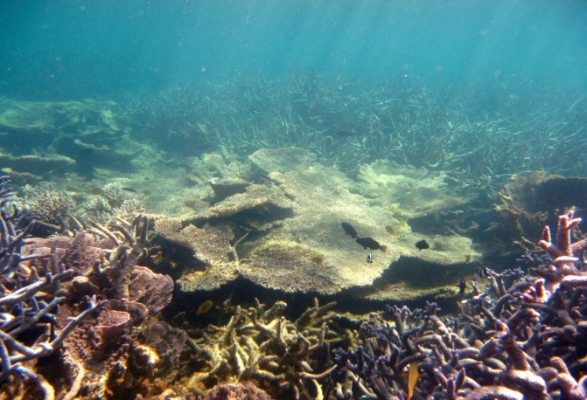
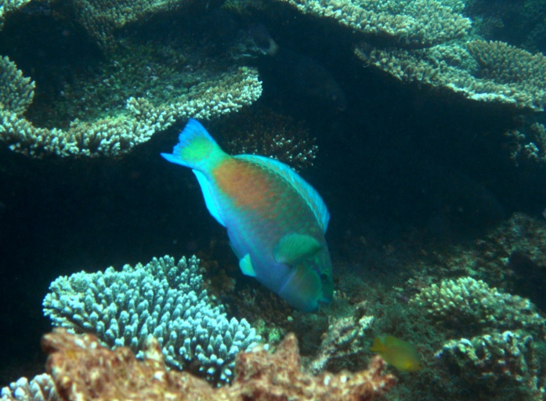
Introduction
Functions are;
  Processes (feeding) – movement or storage of materials or energy (Bellwood et al 2004)
Functional groups;
  A collection of species that perform or influence the same function, irrespective of their taxonomic affinities (e.g. herbivores, nitrogen fixers etc) (Bellwood et al 2004)
Notes:
Read slide

Slide 5
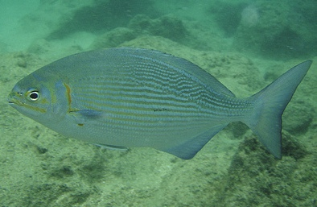
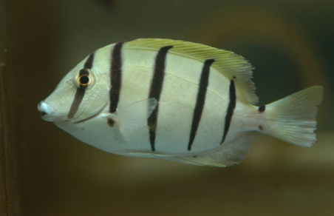
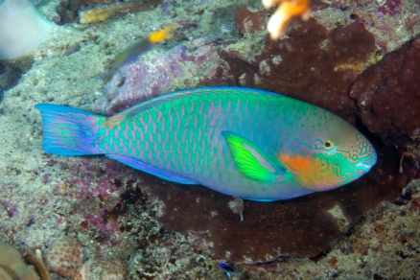
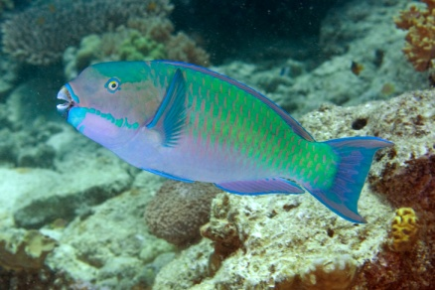
Introduction
4 roving herbivorous groups
Herbivores
Macroalgae
Turfalgae
Browsers
Grazers
Scrapers
Excavators
Notes:
One of the most recognized and studied combination of functions is the following 4 fg of roving herbivores.
DISC PICTURE
The classification of species into a finer functional scale is vital, especially when looking at coral/ma S as 3 of these groups do not feed on ma.
But it is equally important to look at the internal structure of these groups individually to detect cryptic vulnerability or strength.

Slide 6
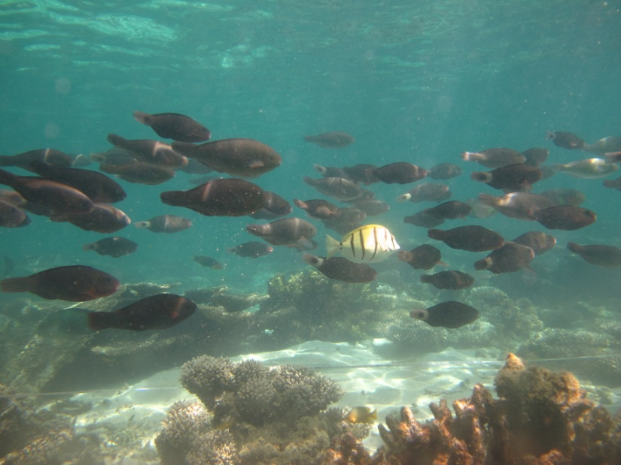
Introduction
Fine scale approach when evaluating resilience:
  Alternative organism (coral/algae)
  Herbivorous fish
    Functional redundancy (same functional role)
    Functional diversity (different functional role)
    Responses
  Non-fish herbivores (sea urchins)
Notes:
So if we want to evaluate the resilience of a process we need a fine-scale approach
And for our process, herbivory, we need to identify
First of all, the alternative organism to coral
Secondly, we need to know the internal structures of our functional groups.
- We need to id species with the same functional role (species that are redundant)
- And how many that differ in their functional roles (this is called functional diversity and we here use generic richness to look this)
- But also how likely they are to respond to disturbance in a similar manner.
Finally, we also need look outside our functional organism and identify other non-fish herbivores, such as sea urchins

Slide 7
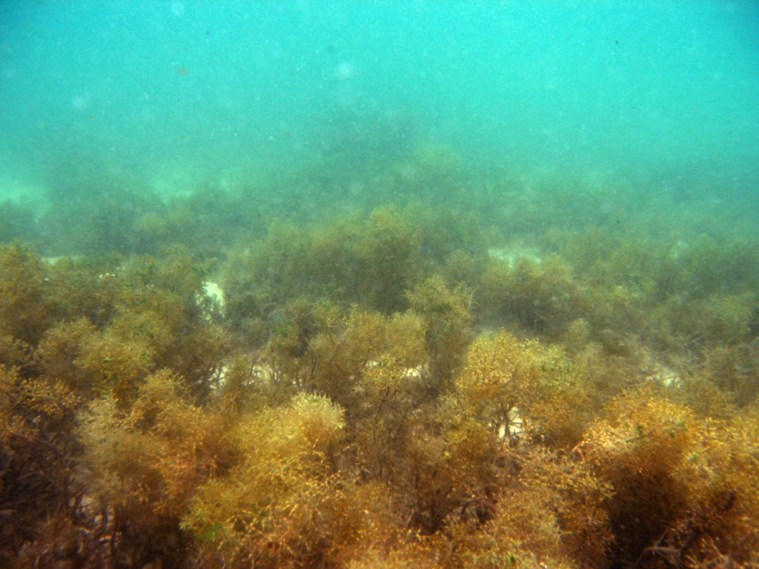
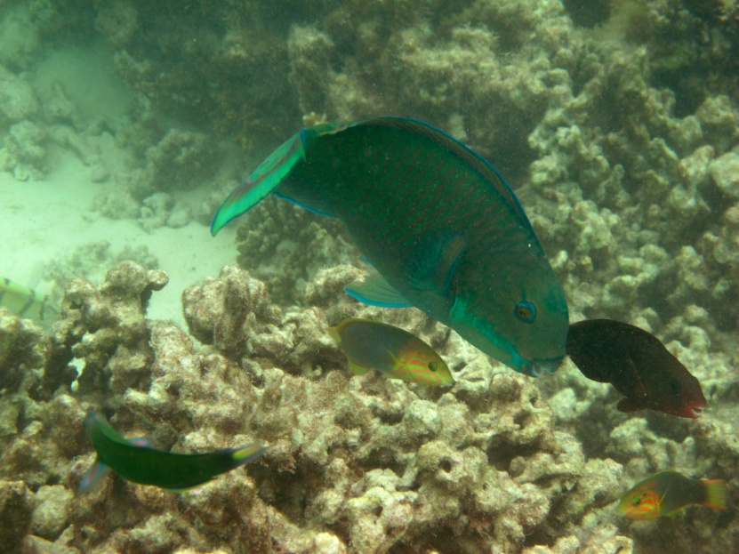
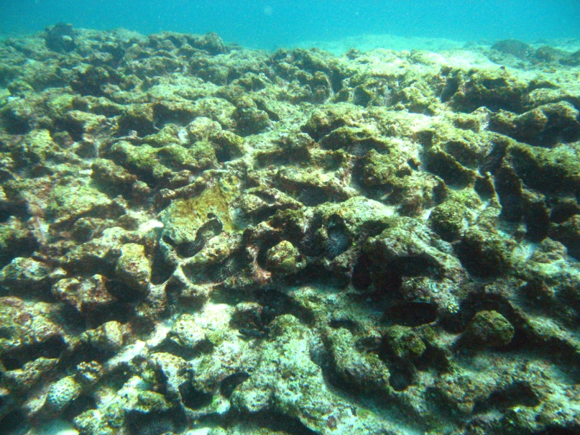
Aim
Quantify the distribution of:
  Macroalgae
  Herbivorous fish
  Non-fish herbivores (sea urchins)
Evaluate the extent to which herbivorous fish and urchins are likely to control macroalgae
Notes:
So this is what I will be presenting today. It is part of a larger study where I have done a fine scale functional evaluation of herbivores on NR.
So the aim of this study was to quantify:
1) The distribution of MA
2) The distribution of herbivorous fish
3) The distribution of other herbivores (sea urchins)

Slide 8
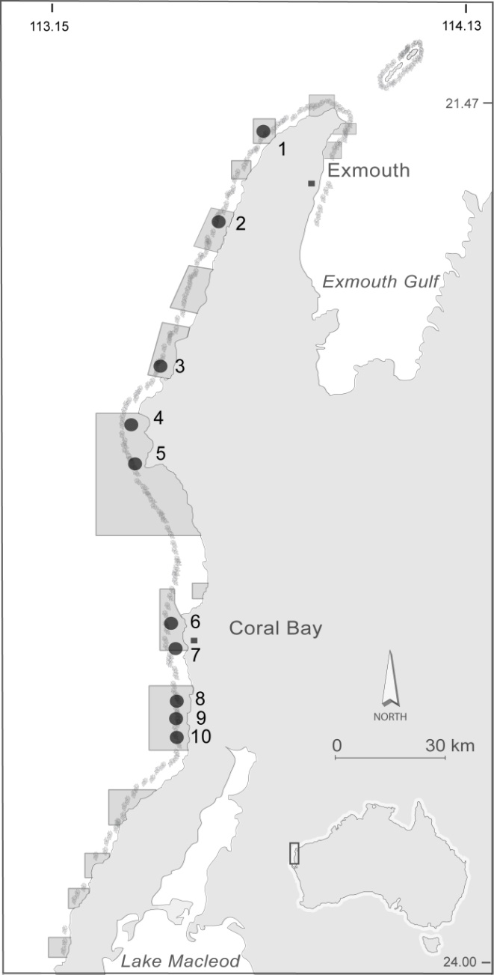
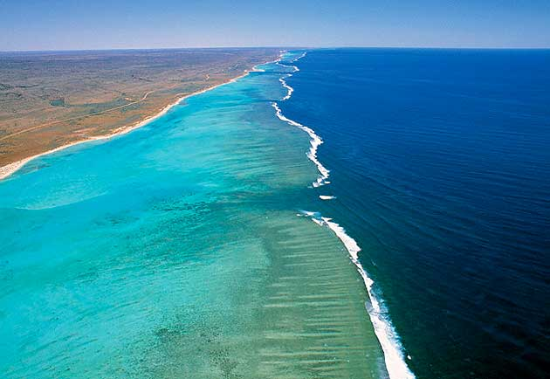
Study location
Ningaloo Reef, Western Australia
Notes:
And to do this we chose one of the few larger remaining reef ecosystems which experience low levels of anthropogenic impacts, NR, WA
It has been protected since the 80’s and has a very narrow shelf. We have 10 site spread over approximately 200 km reef. And we have 3 habitats at each location, SLP, BR and LGN.

Slide 9

1. Alternative organisms
Notes:
So the first thing we did was to look at coral cover vs ma cover. This to see what the relationship between these alternative organisms look like in case there would be a loss of coral.
Present fig.
So what we are finding is that where there is lots of coral we have less ma. This is expected.
However, what is interesting is the amount of algae found in the lagoon (seasonal sargassum at a height of 1.5m, each year covering 22,000ha). This is not what we are used to see in healthy systems.
So is this cross-shelf pattern the result of a shortage of herbivores? So lets look at the herbivorous fish.

Slide 10
2. Herbivorous fish
Density of herbivores
Notes:
So looking at this scale of functionality, these fg look ok with grazers looking real strong. We can also see that browsers are happy to inhabit habitats with more ma, suggesting that it is not a lack of browsers that are resulting in high biomass of ma in lgn.
But using this scale only to look at the status of a pop is not very informative
Instead we need to know what the internal structure of each of these fg look like in terms of functional redundancy and functional diversity?

Slide 11
2. Herbivorous fish
Excavators
Abundance (%)
Grazers
Slope
Back
Lagoon
Notes:
Here are two examples:
Describe fig
Excavators: NR only have 2 species. They belong to the same genus, therefore have the same role and are likely to respond to a disturbance in a similar manner. Further, this group is strongly dominated by one of these species. This doesn’t leave much buffering in case this species would be negatively affected by a disturbance.
In contrast Grazers has: plenty of species and genera. They have the different roles and are likely to respond to a disturbance in a different manner. Therefore the buffer to compensate for the potential loss of a dominant sp is larger.
So what this shows us is that a fine scale approach is very important to get a more complete picture of the status of a process. Using this approach we see that excavators signal vulnerability especially if C. sordidus would reduce in numbers.
So this leads us to the next part of this talk, is there a buffering capacity among other organisms for this fg?

Slide 12

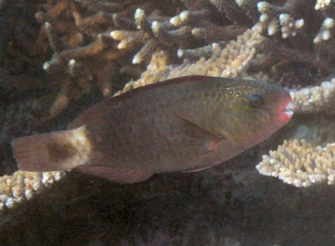
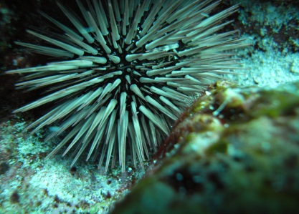
3. Non-fish herbivores
Notes:
One of these organisms are herbivorous sea urchins. The dominant one on NR, Echinometra mathaei, not only feed on algae but also contribute to bioerosion. So its function is similar that of to excavating fishes.
So we looked at their distribution and compared their abundance with excavators.
Lots urchins on the slope compared to the other habitats but also compared to fish. And this is interesting. But lets ignore that for a bit and concentrate on function, bioerosion. And what we can see here is that despite huge variations in density on the slope they contribute to a similar amount of bioerosion.

Slide 13
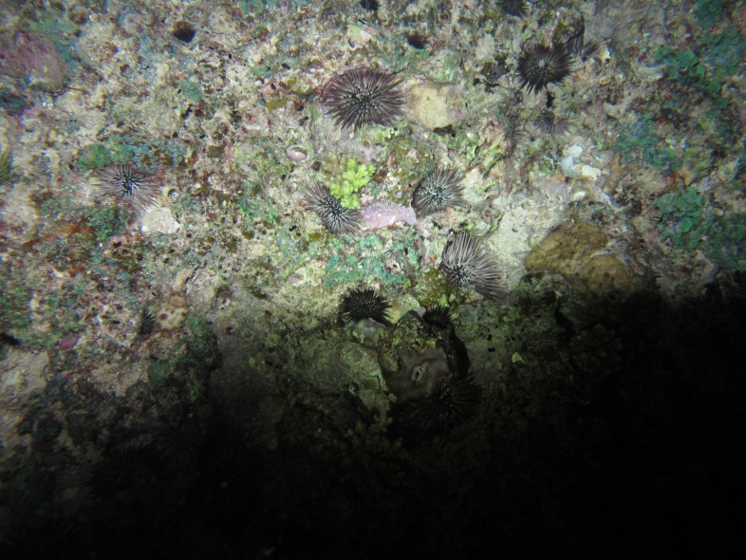
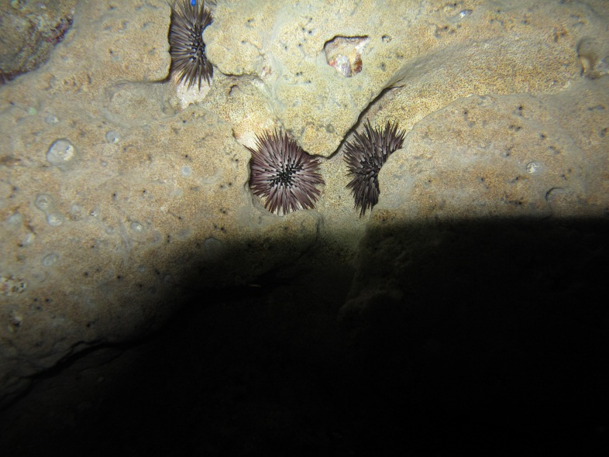
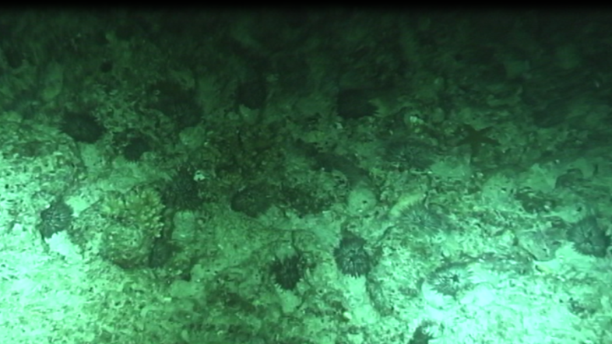
3. Non-fish herbivores
Important role on Ningaloo Reef
What is driving the pattern of urchins, especially on the slope
Is it a lack of predators?
Urchins = reef degradation
Notes:
So this shows us that urchins have a very important role on NR.
So what is driving these patterns? Lack of predators?
Urchins in too many numbers are linked to reef degradation and often overfishing of key predators. So lets id urchin predators on NR and look at their distribution.

Slide 14
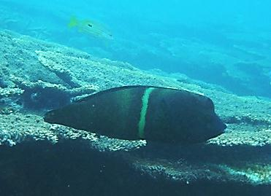
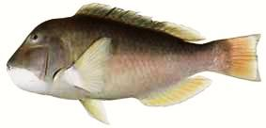
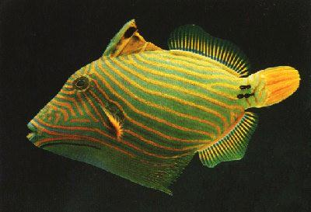
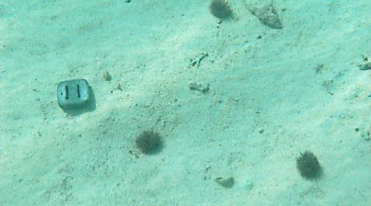
3. Non-fish herbivores
Notes:
We tethered urchins (E. mathaei) non-intrusively by tying them to a dive weight using fishing line. We then recorded number of predation events on video.
And found that the main predator on NR is different from what has been reported from other parts of the world (such as the GBR and East Africa).
In those locations, balistids (triggerfish) are the dominant predator while on NR we are finding that Labrids (wrasses) appear to be the main predator.
Two species stood out in our tethering experiment, C. aygula and C. rubescens (show picture). C. rubescens is highly sought after fish in terms of recreational fishing and endemic to WA.
This shows that we have identified a urchin species with a similar function to excavating herb but which tend to be sensitive to top-down control. So lets have a look at the predatory distribution.

Slide 15
3. Non-fish herbivores
0.640
0.537
0.423
Notes:
Density of the 4 main predatory families.
So what we see here is that the distribution of predators is not very different across habitats.
We have more predators on the slope where we have more urchins.
So it appears that it is not a lack of predators that are driving the cross shelf urchin pattern. However, the internal structure of the balistid group reveals an overall lack of large well known balistid predators.

Slide 16
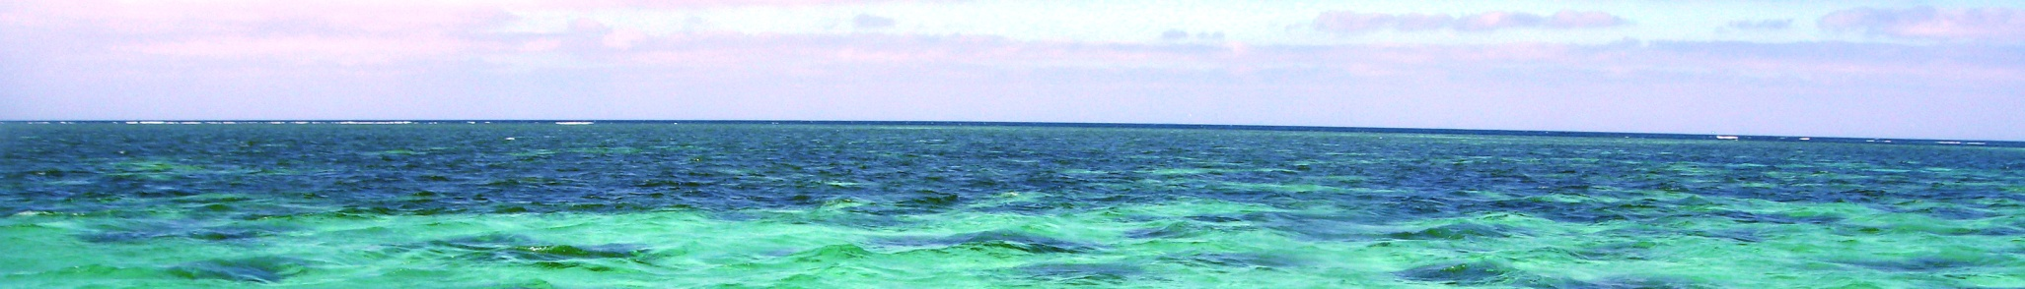
Conclusion
Macroalgae abundant in lagoon (despite herbivores)
Urchins abundant on slope (despite predators - except specialist balistids)
Urchins and algae often signs of degradation - here they appear to not be
Ningaloo Reef, although relatively intact, appears to be functionally distinct to other reef systems
Notes:
We are finding that macroalgae is abundant in the lagoon, despite no apparent lack of herbivores
Further we are finding that urchins are abundant on the slope despite no lack of predators. However there appears to be a lack of large balistids.
Urchins and macroalgae often considered to be signs of degradation - here they appear to not be despite their very high abundance.
NR appears to be functionally distinct to other reef systems.

Slide 17
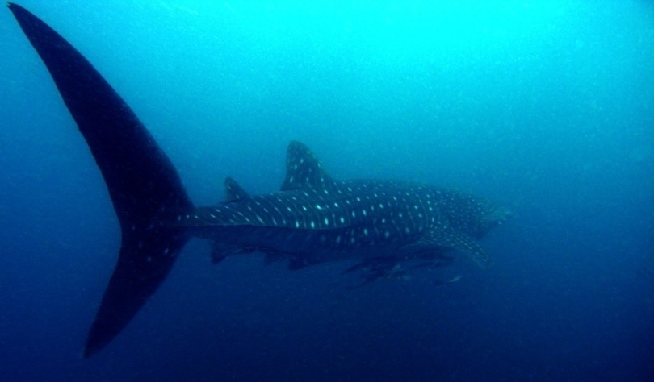
Acknowledgements
Prof D. Bellwood, Dr. M. Depczynski, Dr. A. Hoey and I. van de Leemput
JCU, ARC Centre of Excellence
AIMS, AIMS@JCU, DEC
Colleagues in the lab and field
Notes:
Thank you

